Slide 1
CERN Internship
Collaboration Mapping in Physics

Slide 2
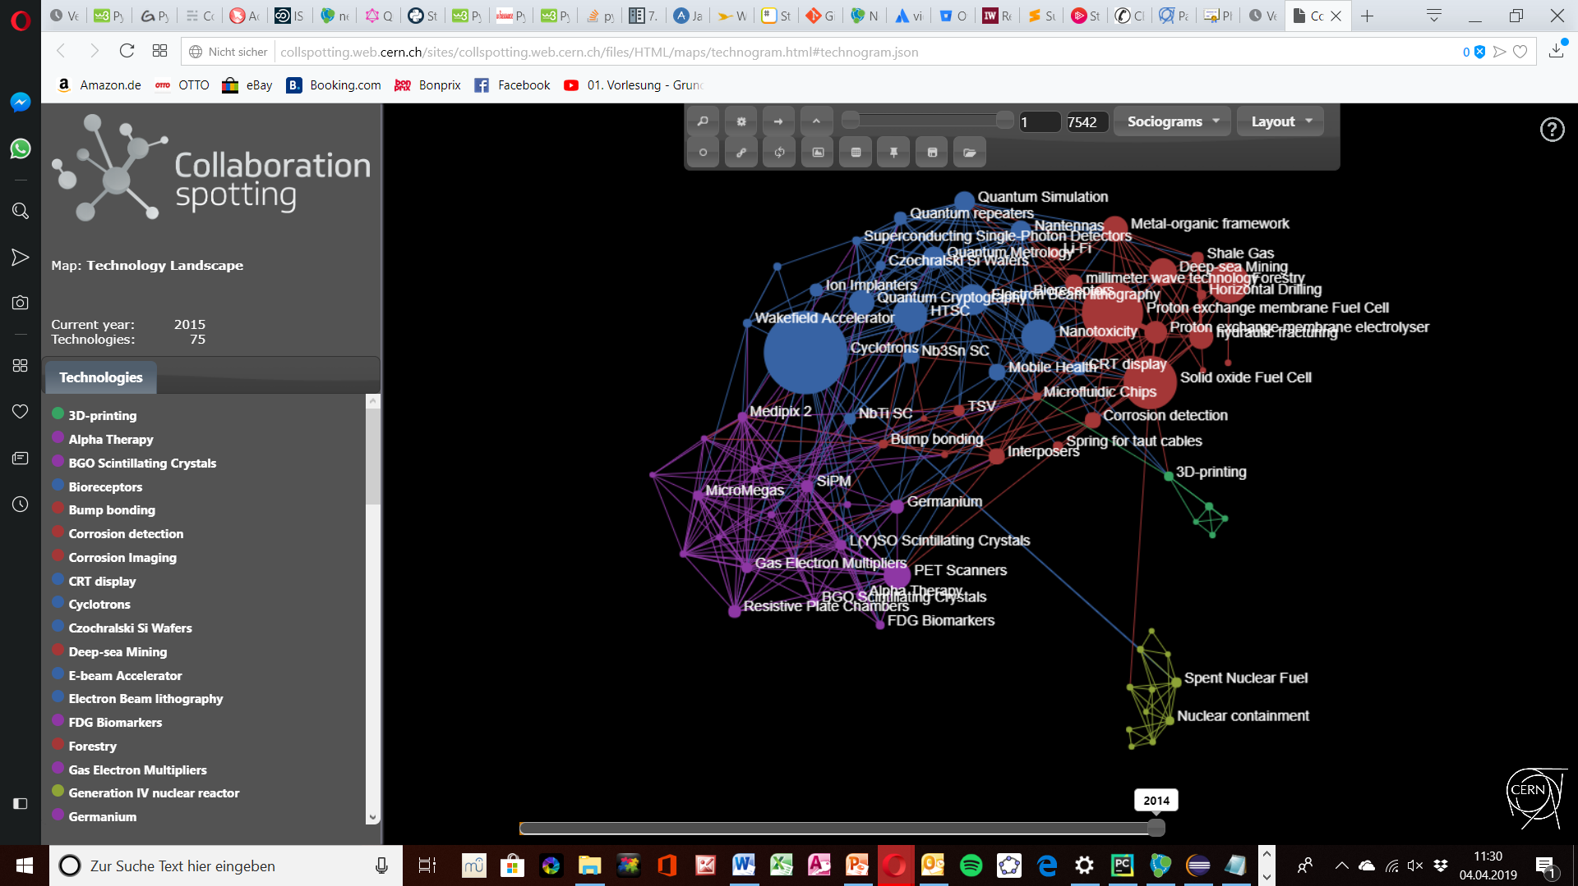
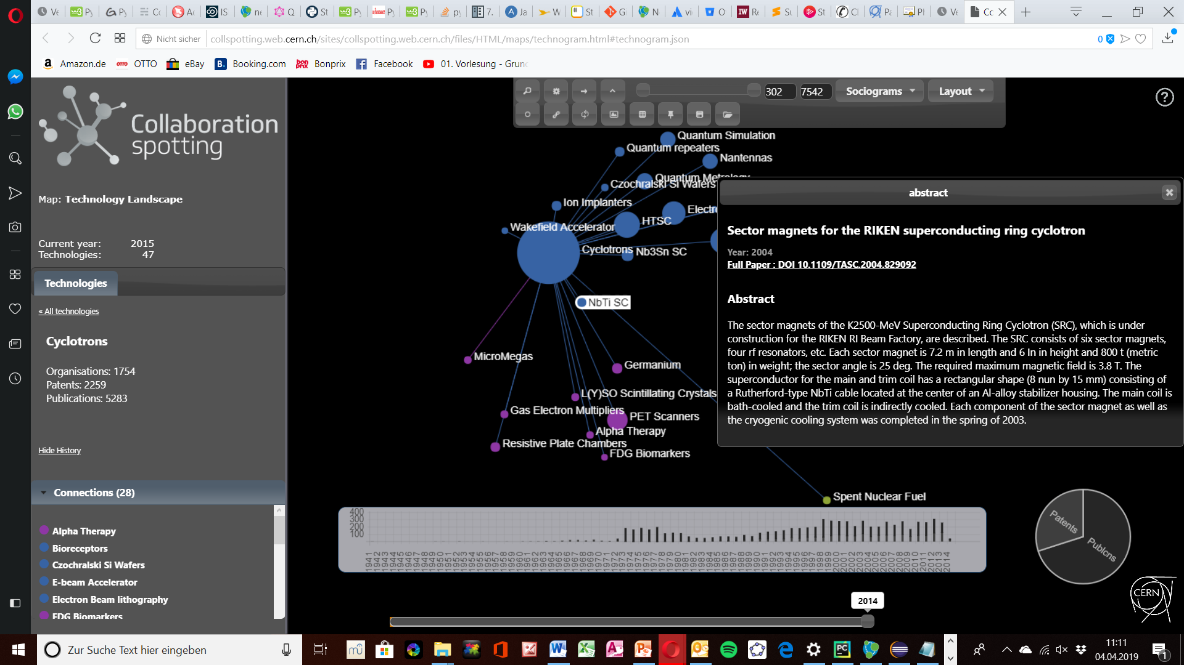
Collaboration Spotting

Slide 3
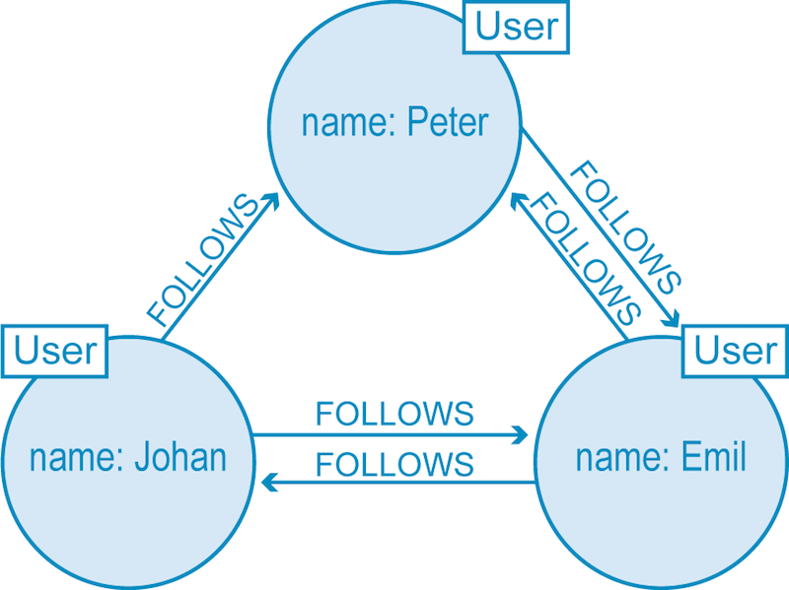
Graph Databases
Nodes (Entities)
Edges (Relations)
Graph structured database
Useful for heavily inter-connected data
Requieres a own query language
Properties
Notes:
Relations are strored explicitly within the database → contrast to SQL based databases

Slide 4
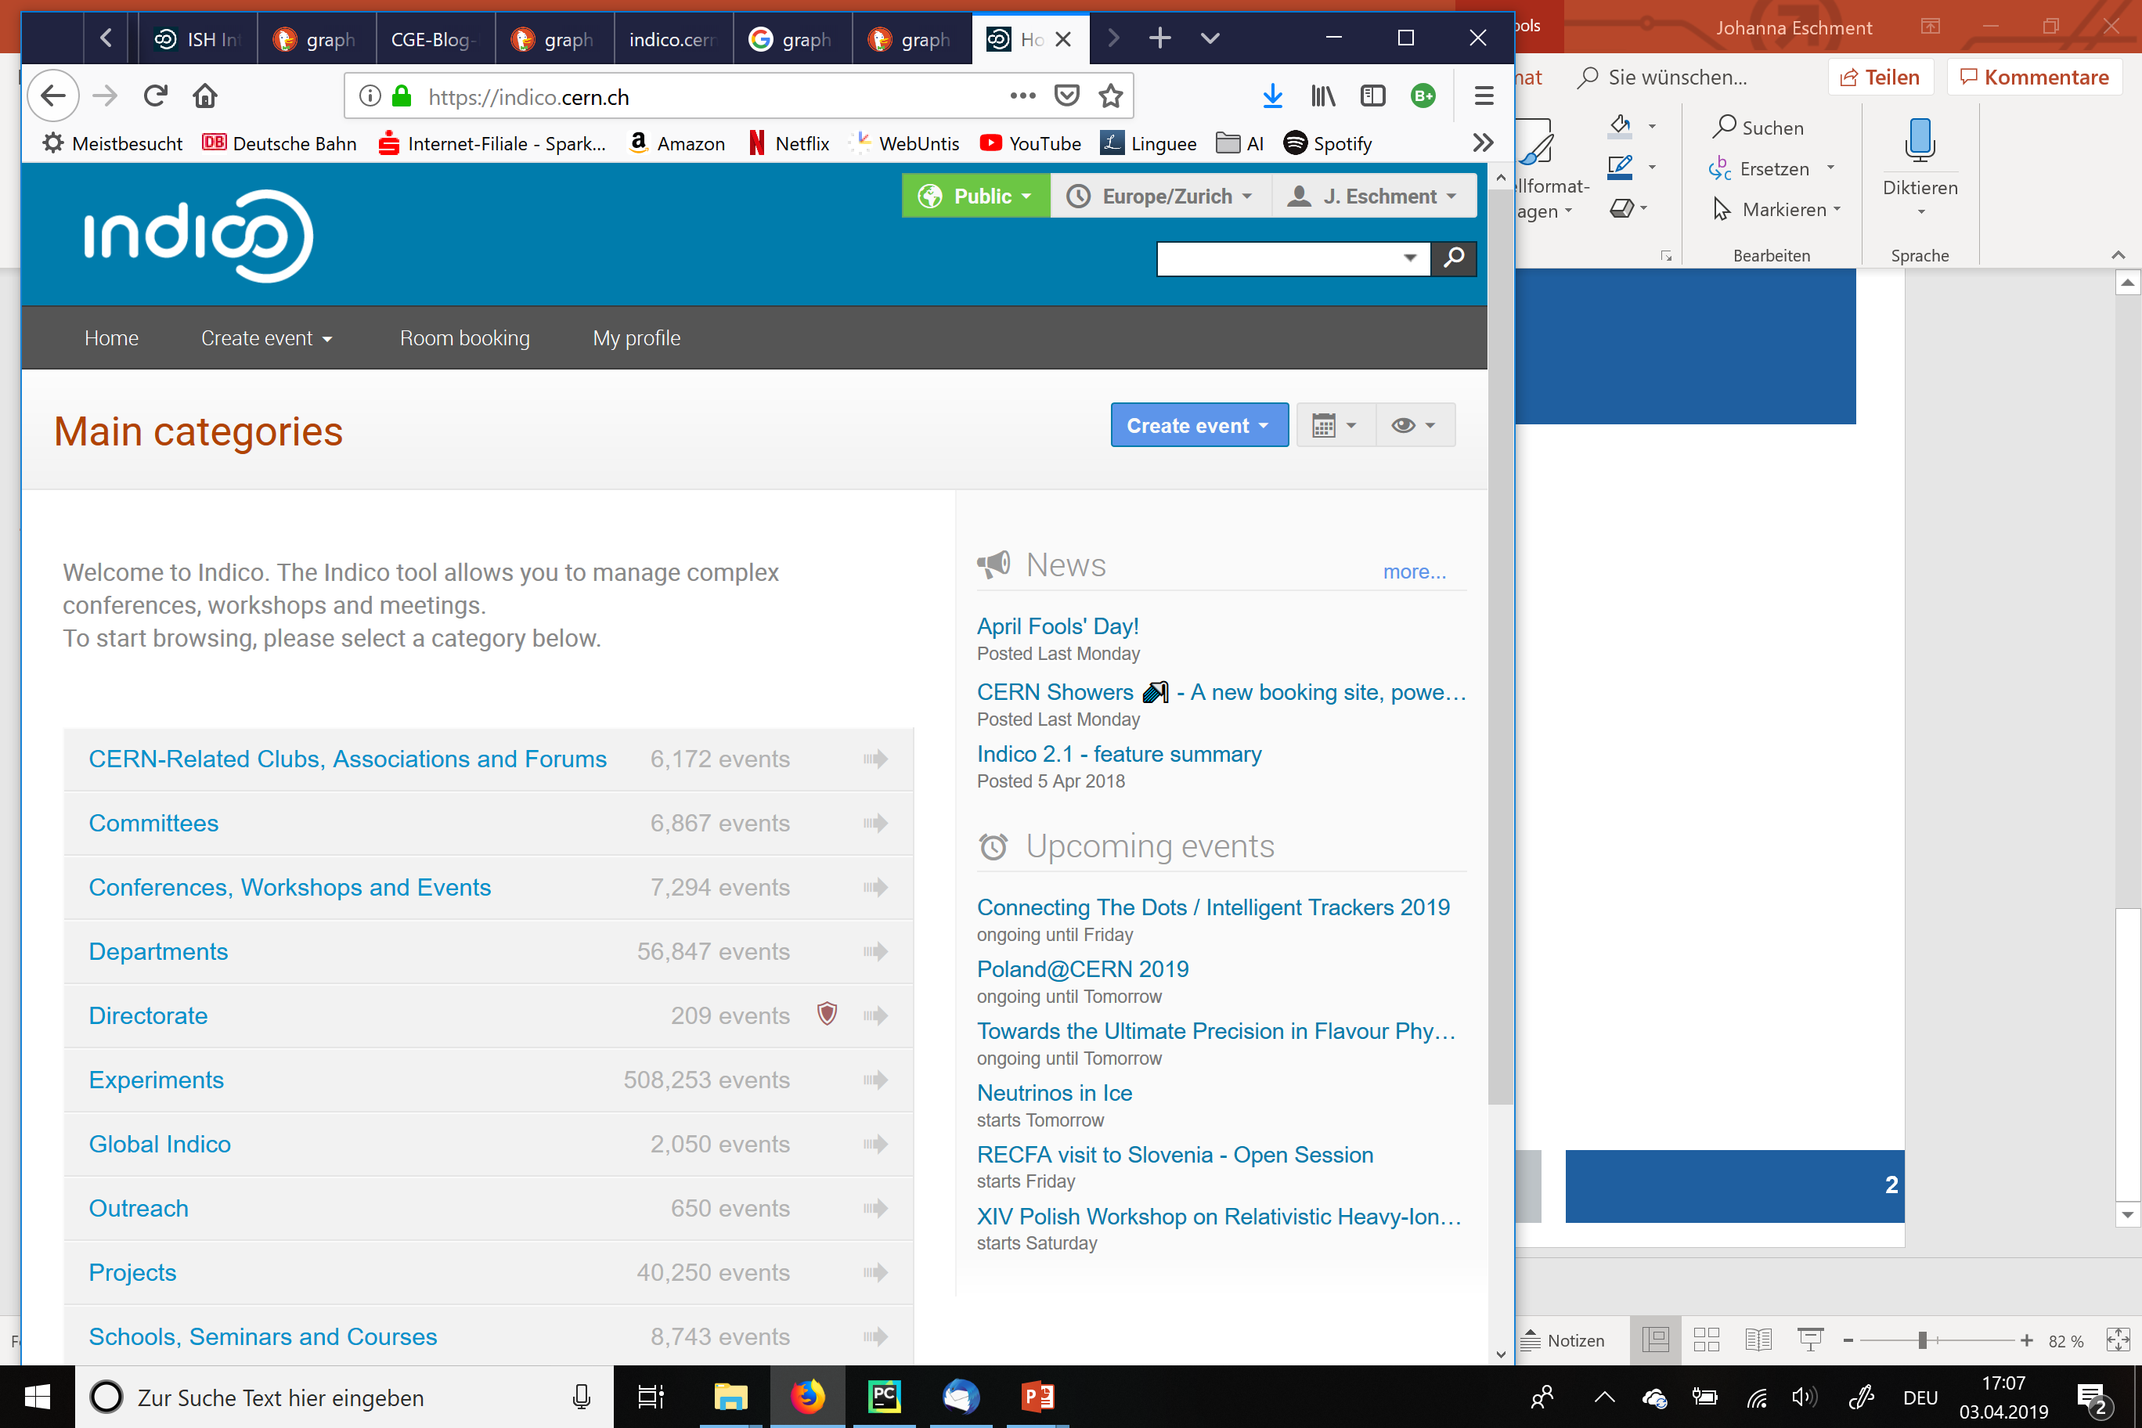
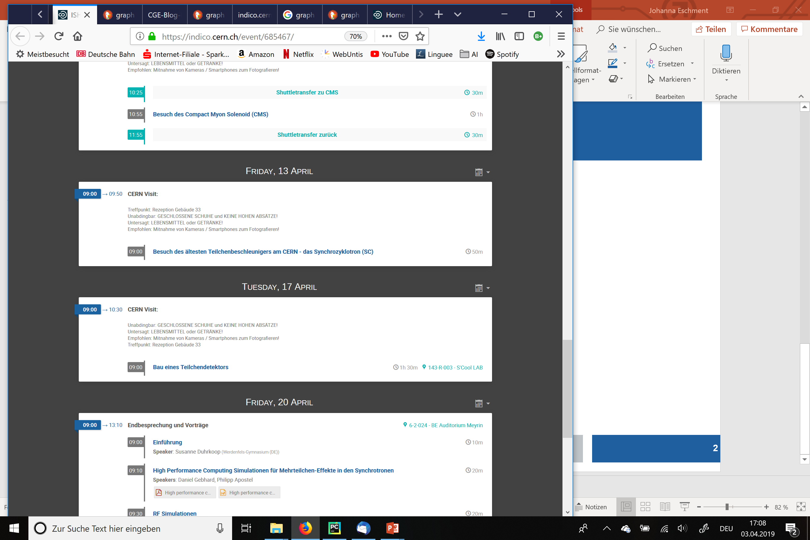
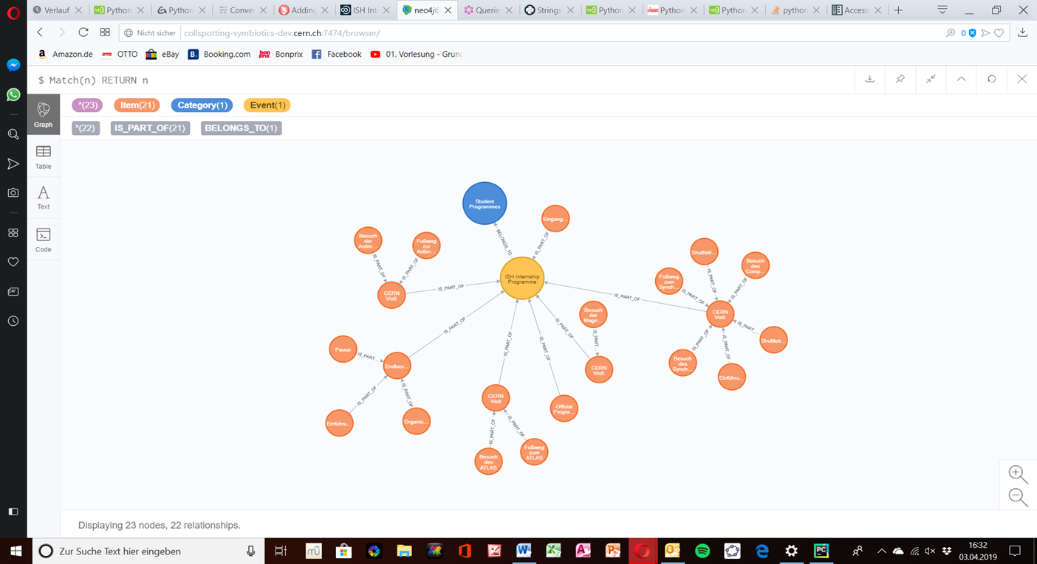
Our Goal: Graph Database of Indico

Slide 5
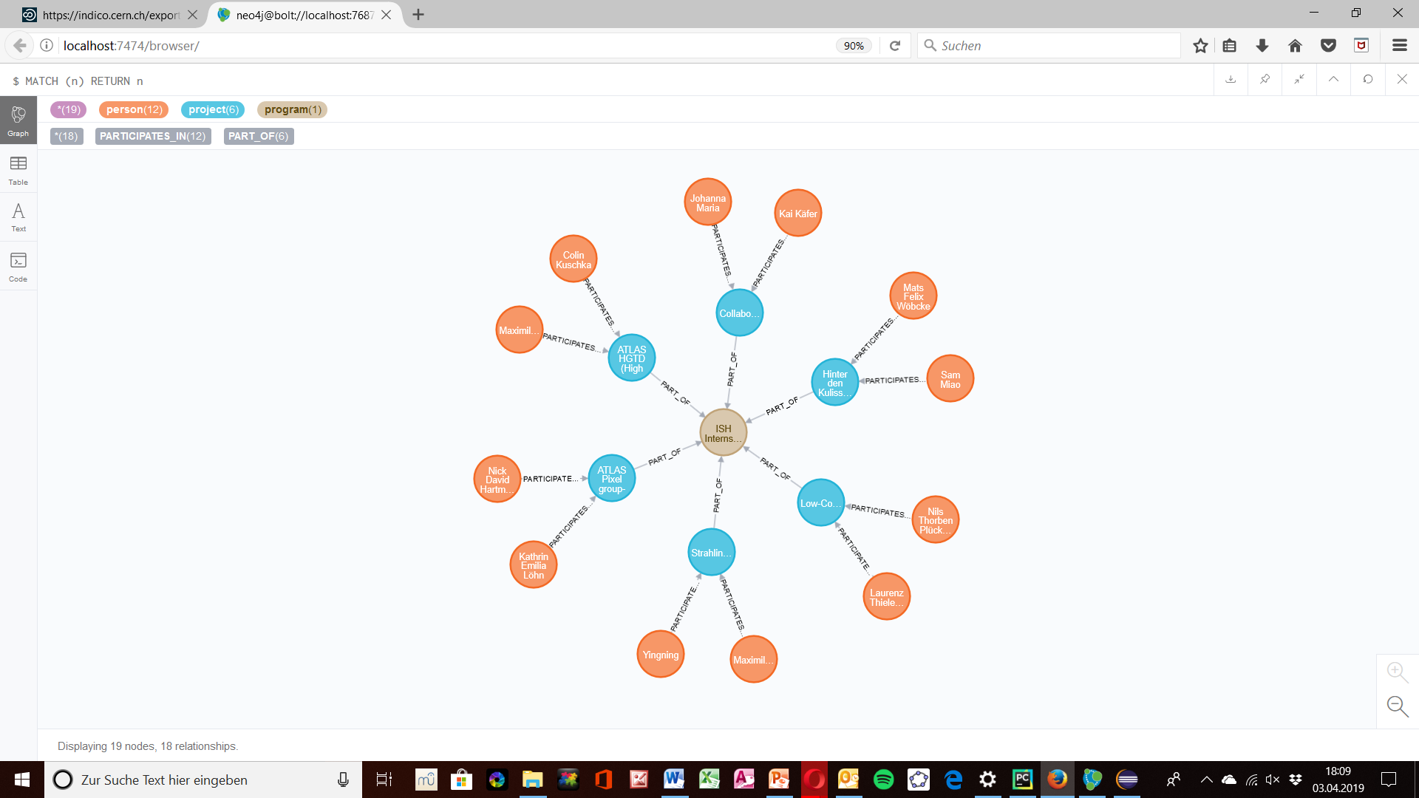
Neo4j
Command line for the Neo4j Cypher language
Illustration of the graph

Slide 6
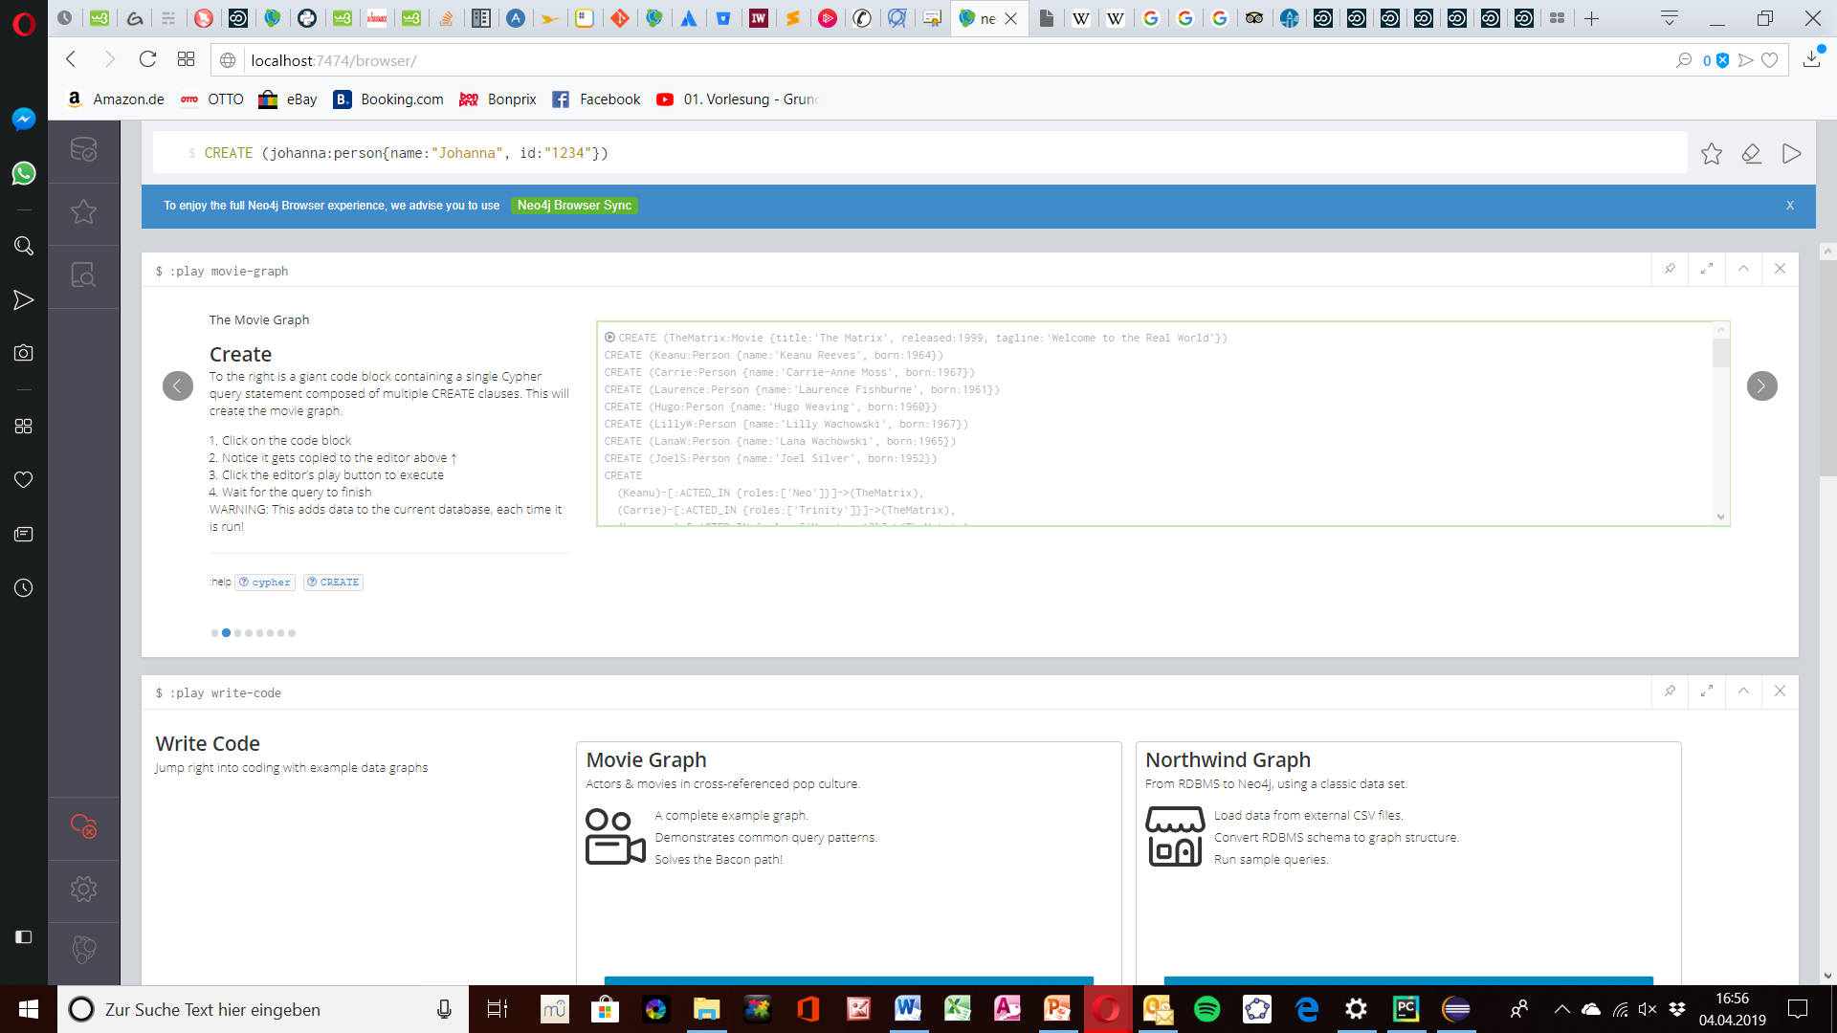
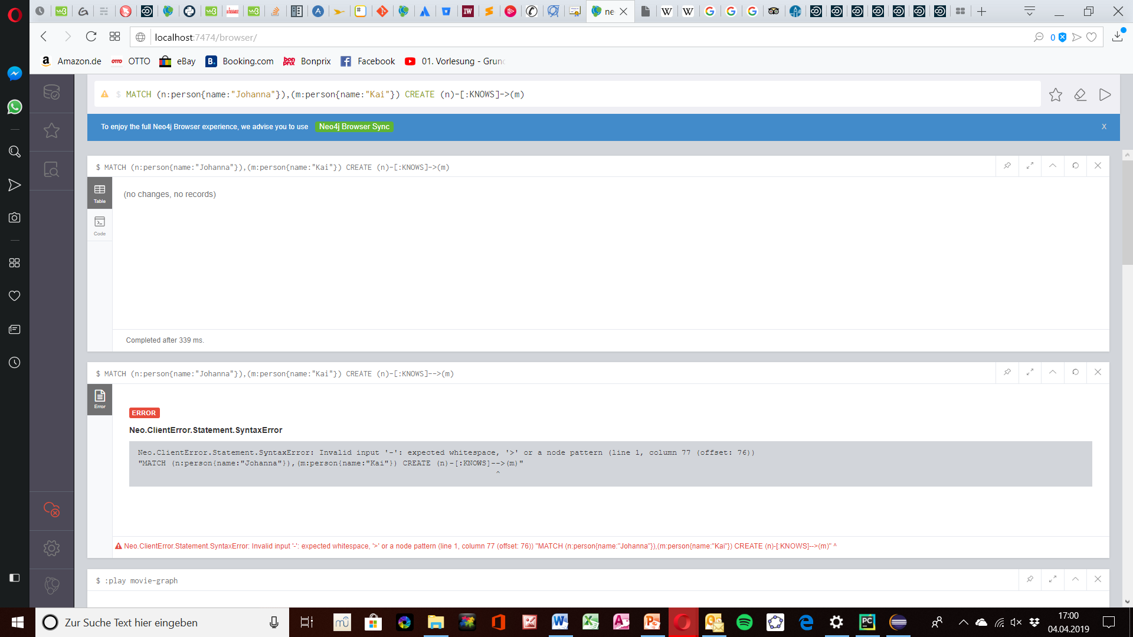
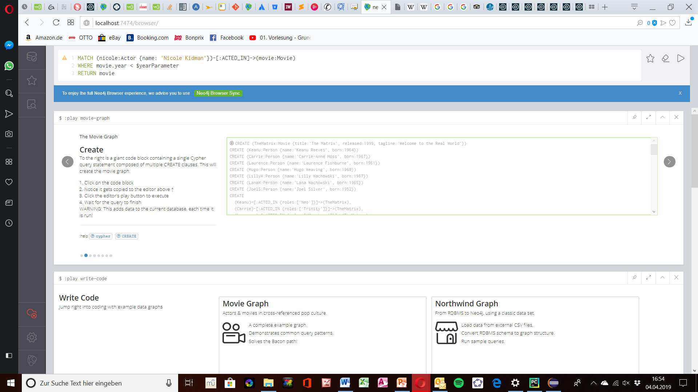
Cypher Language

Slide 7
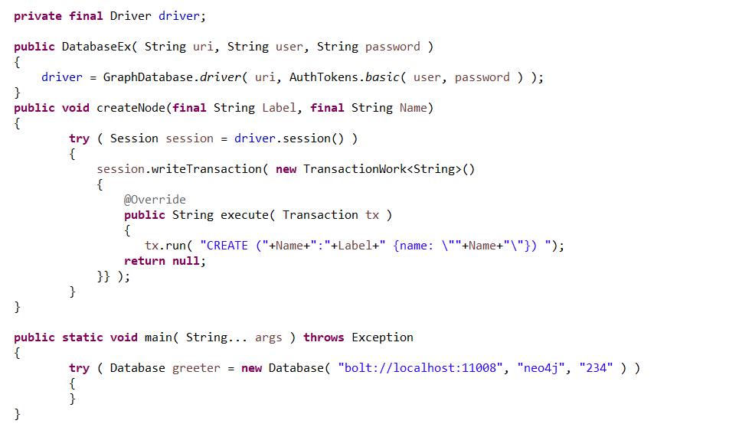
Neo4j with Java
Login to your database in Neo4j
Cypher command

Slide 8
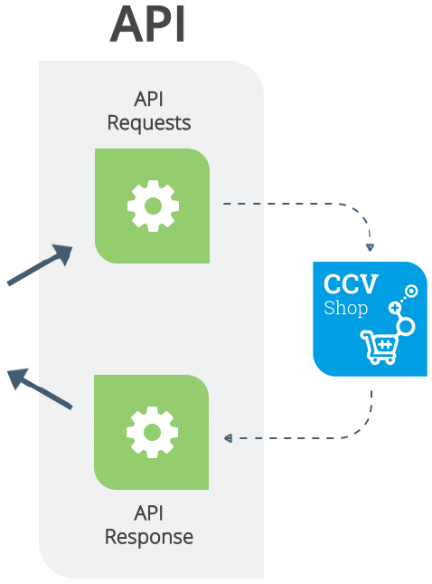
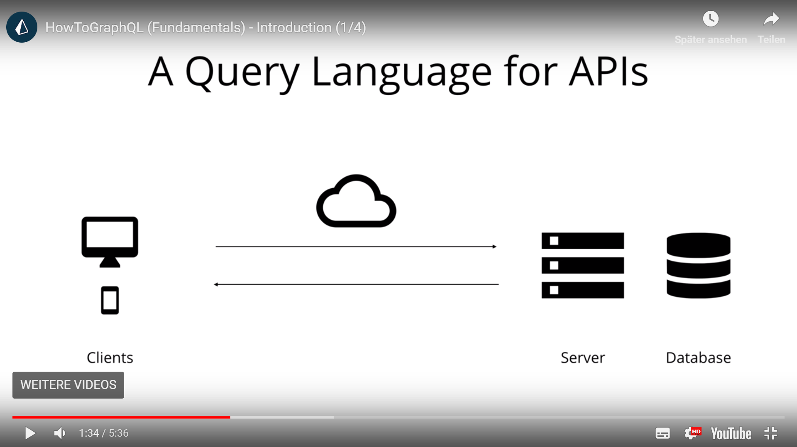
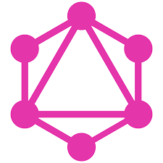
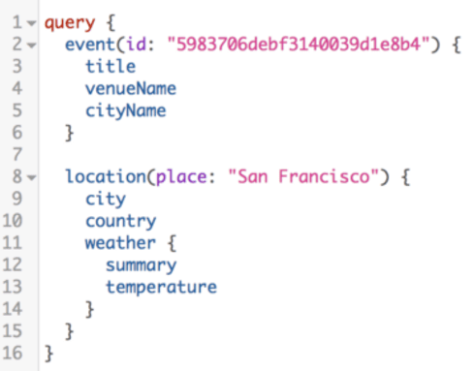
APIs

Slide 9
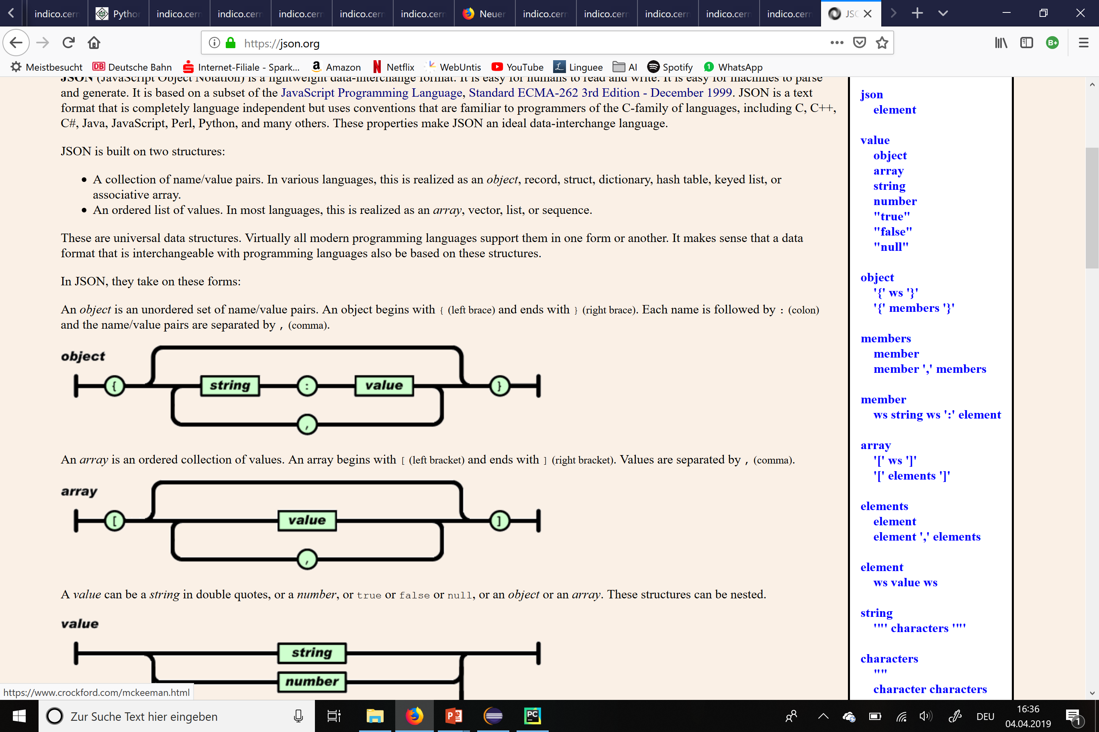
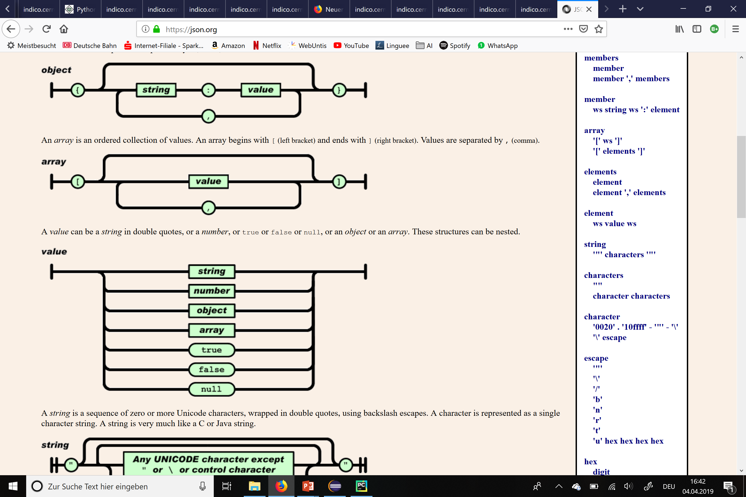
GraphQL: Based on the Data Type JSON

Slide 10
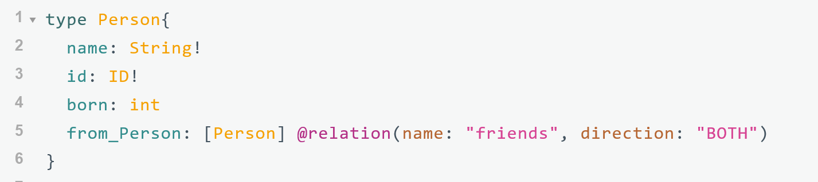
GraphQL: Schema
Nodes as types:
Property
Edge

Slide 11
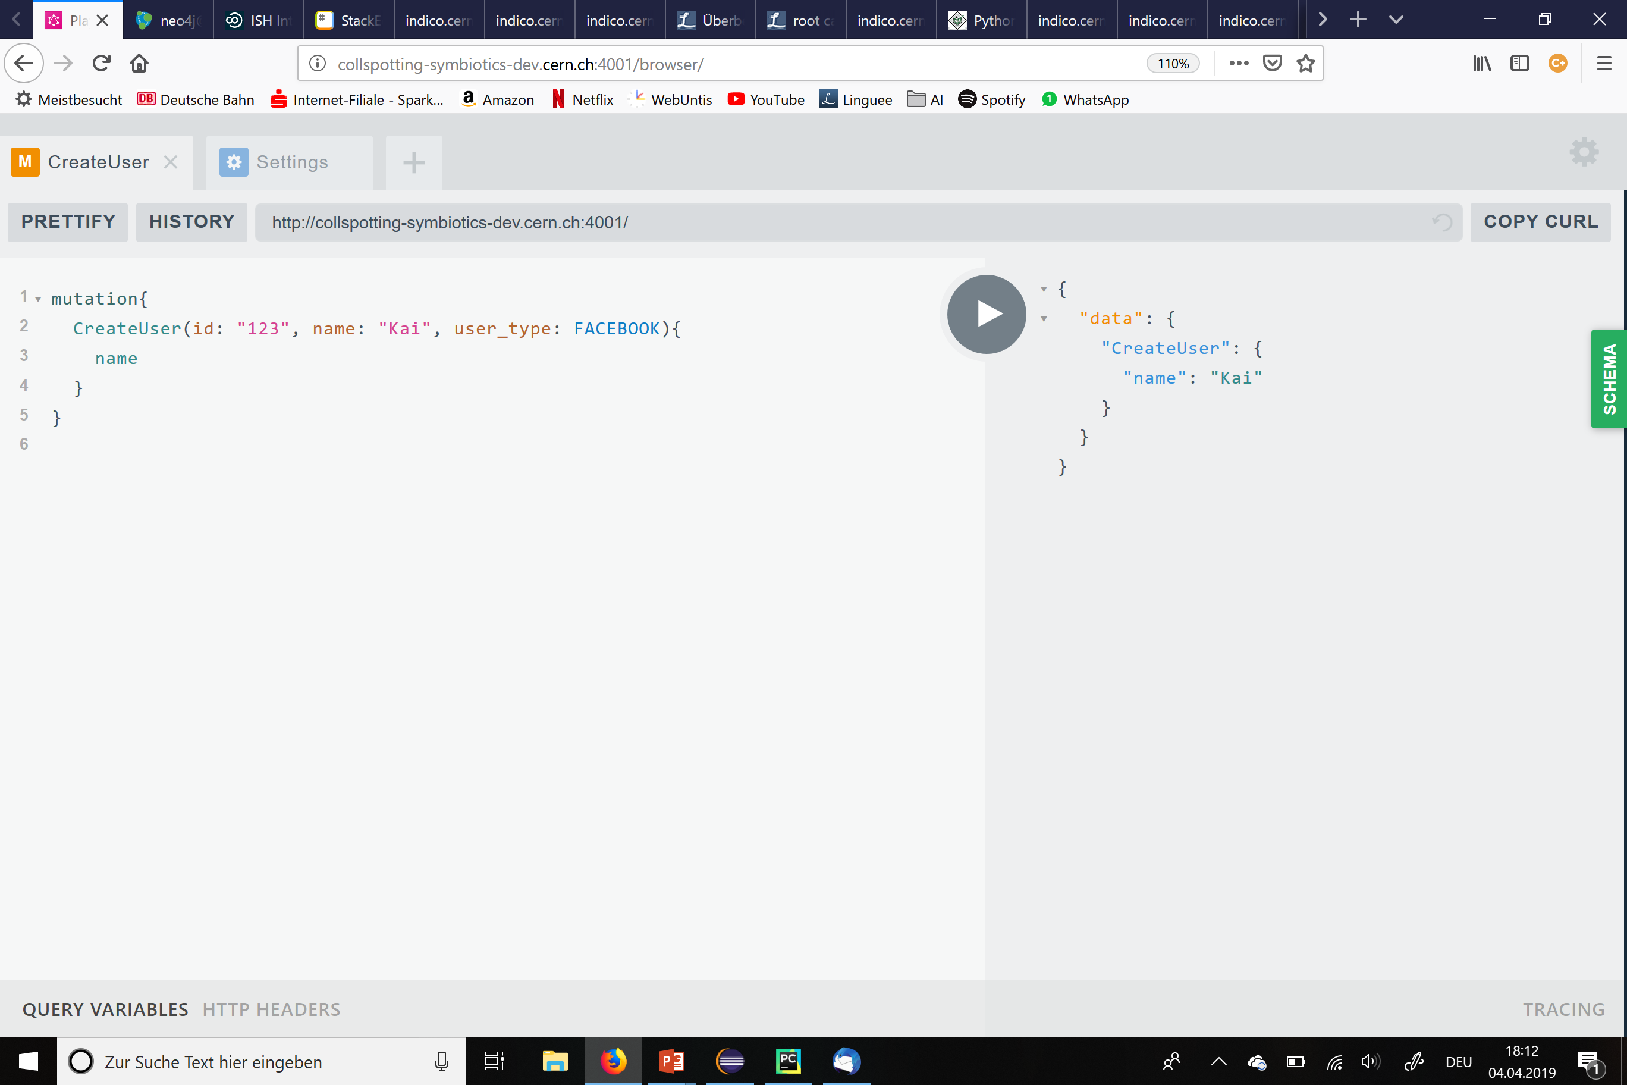
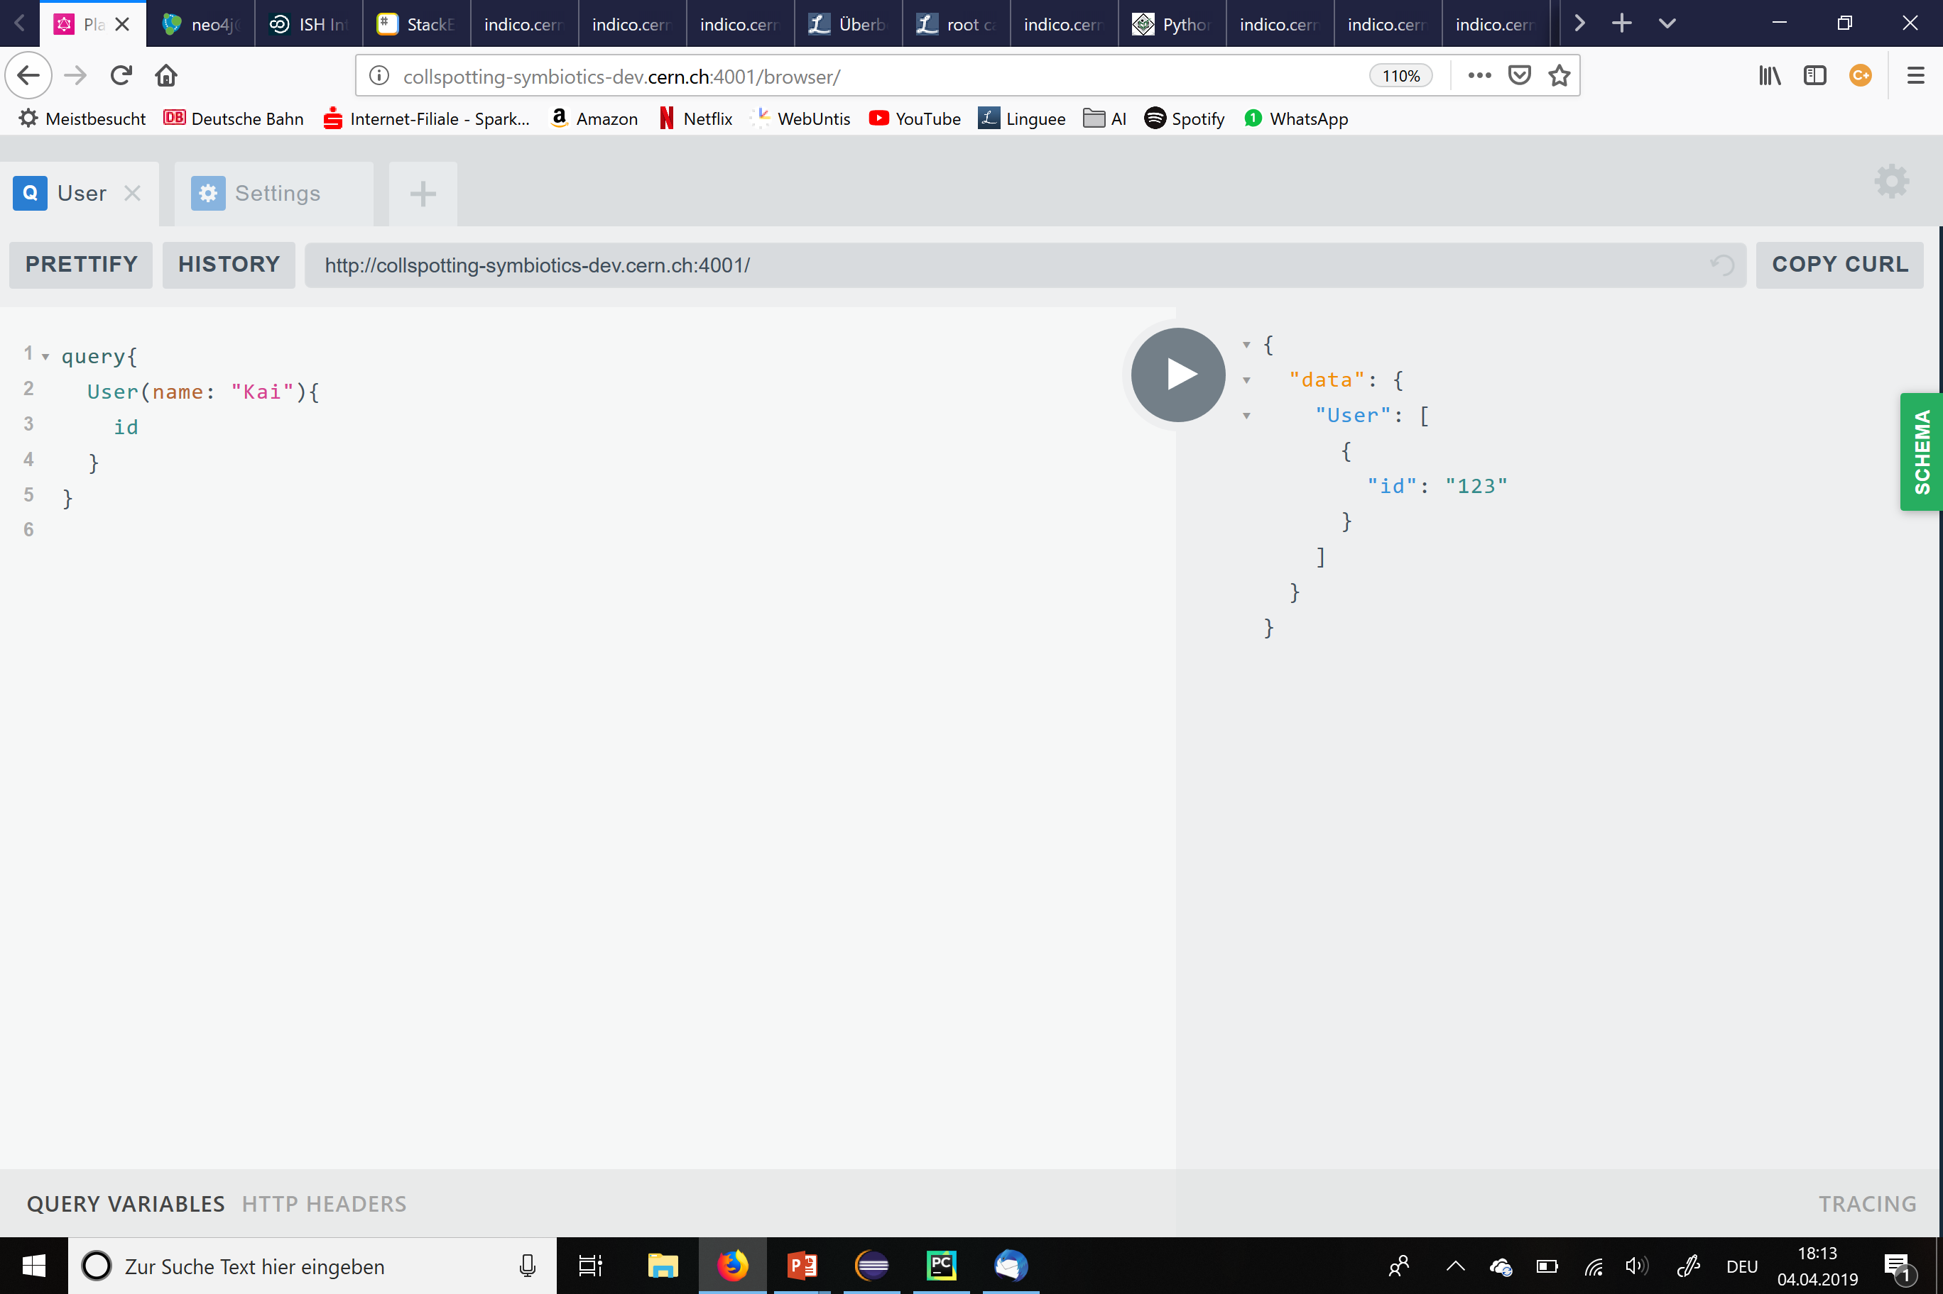
GraphQL: Queries and Mutations

Slide 12
Our own Schema of Indico
Item
id
name
description
starts
ends
file
id
title
url
place
id
country
address
building
room
Person
id
name
Institution
id
Name
Category
id
name
Category
manages
Person
belongs to
participates
works for
Event
is head of
Institution
is part of
Event
id
name
description
startDate
endDate
Item

Slide 13
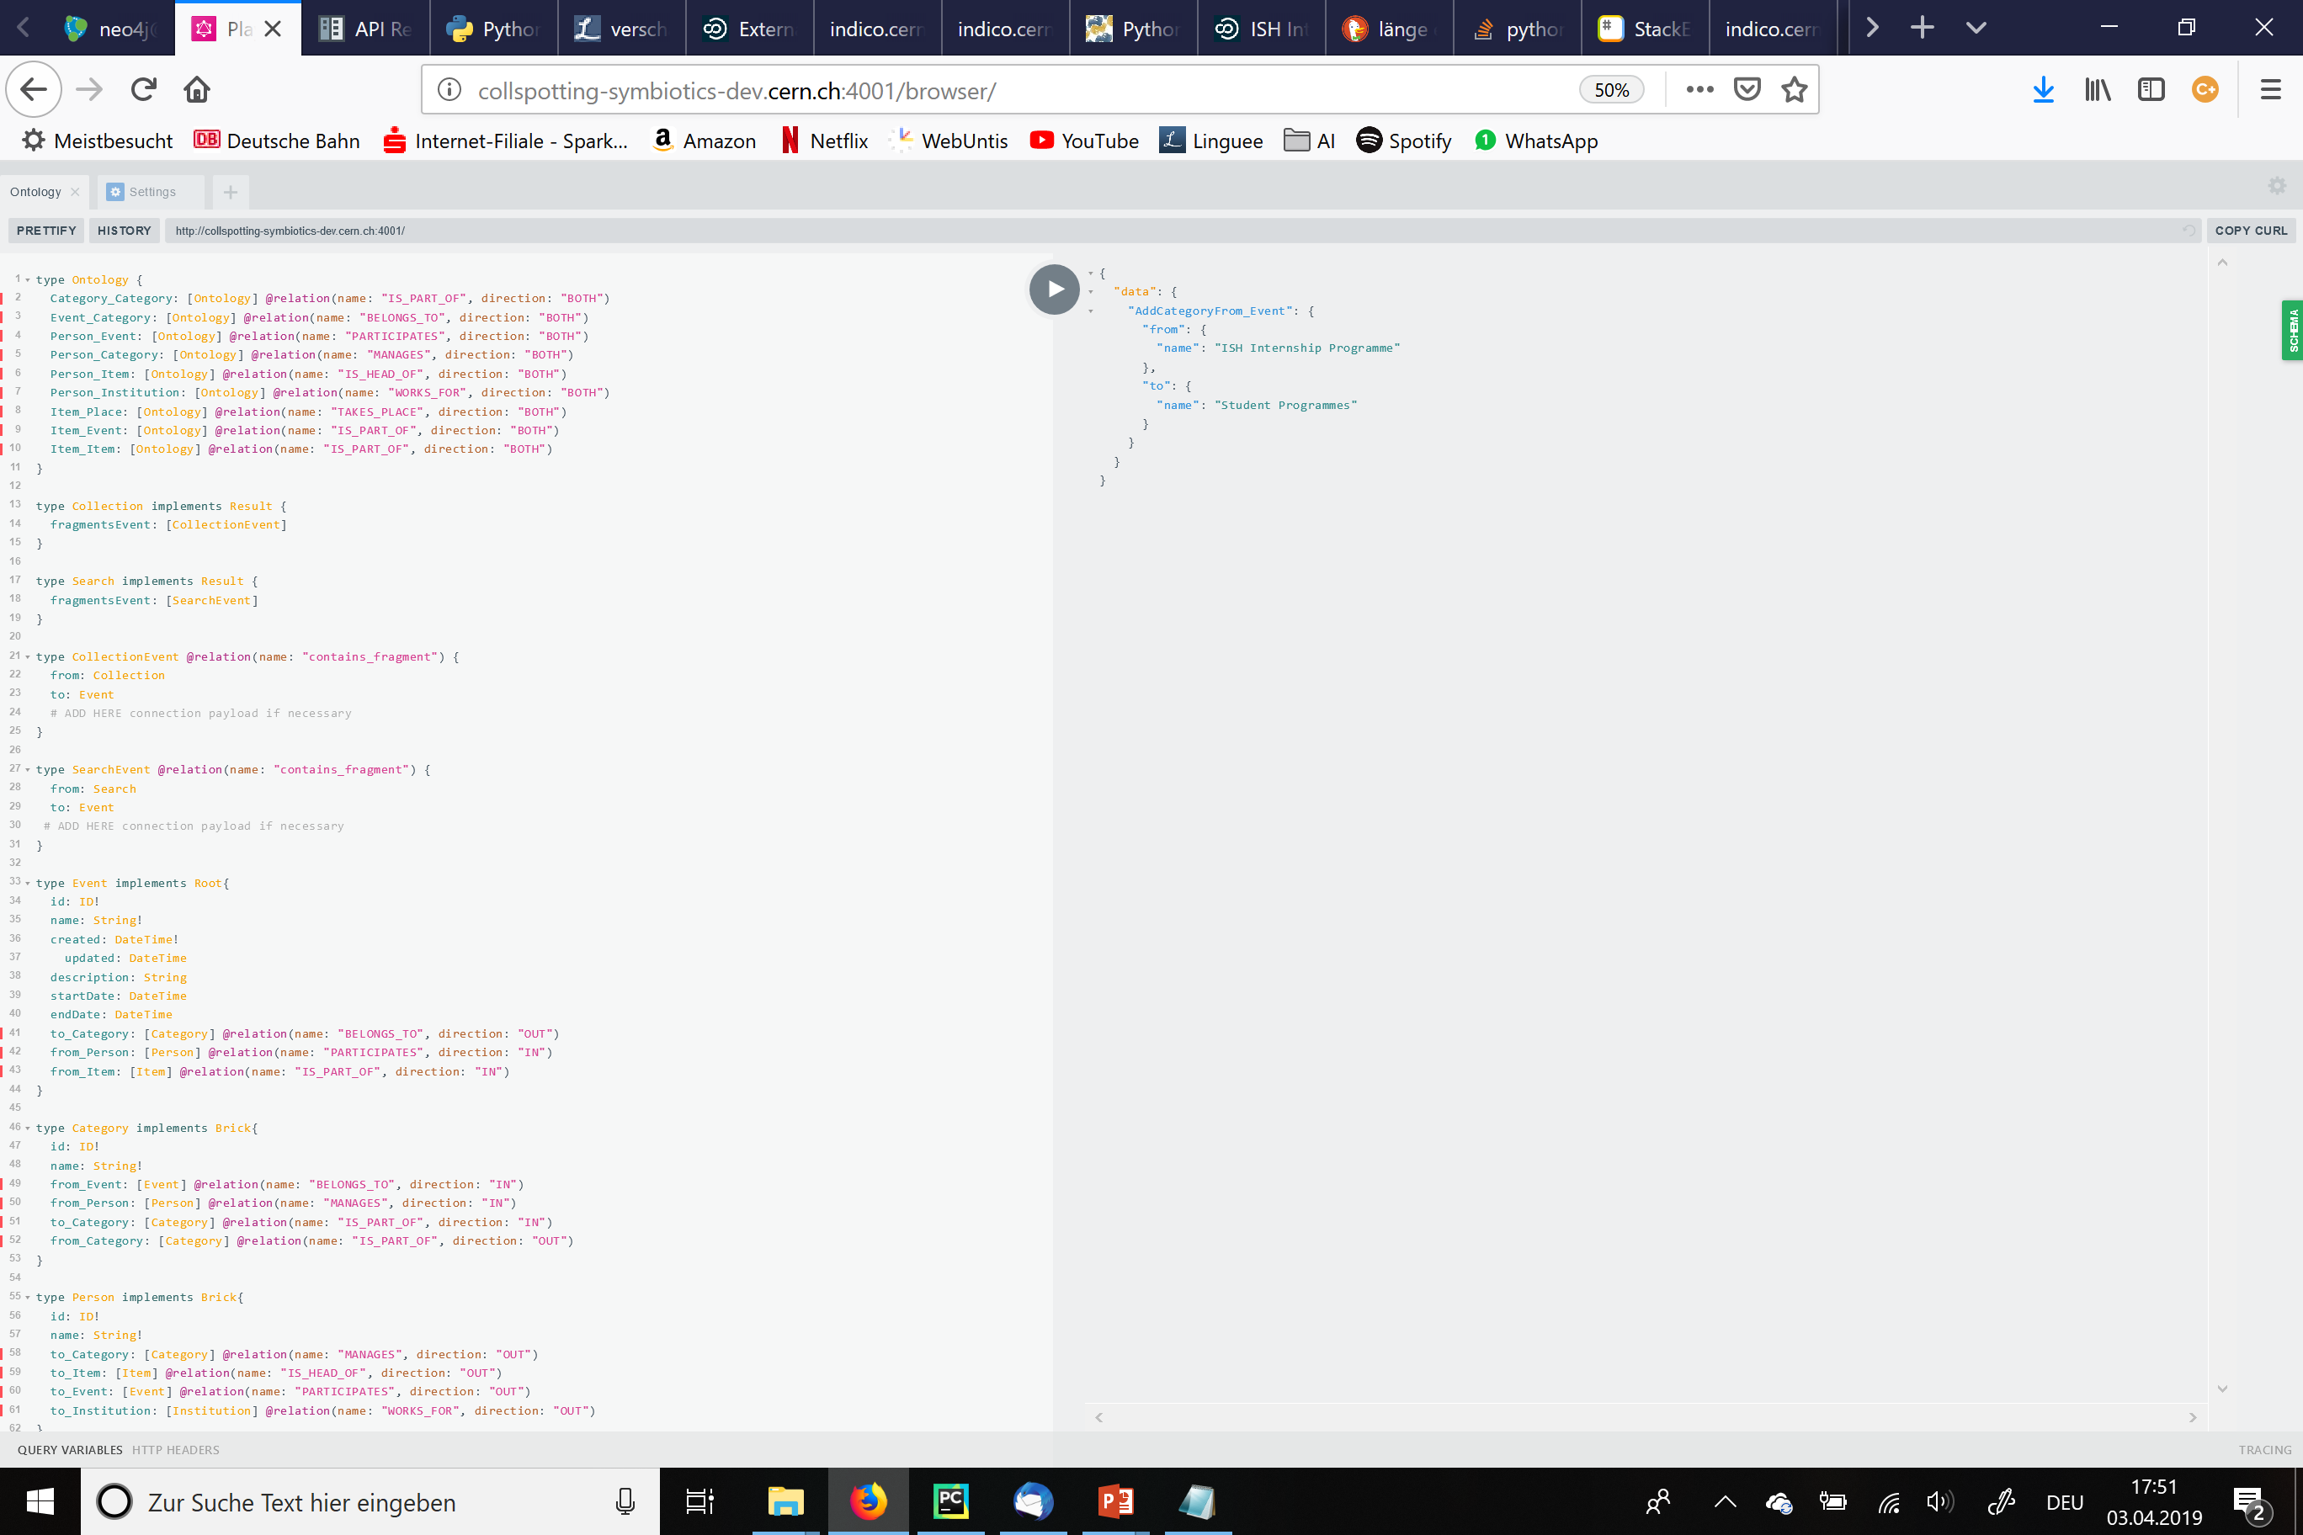
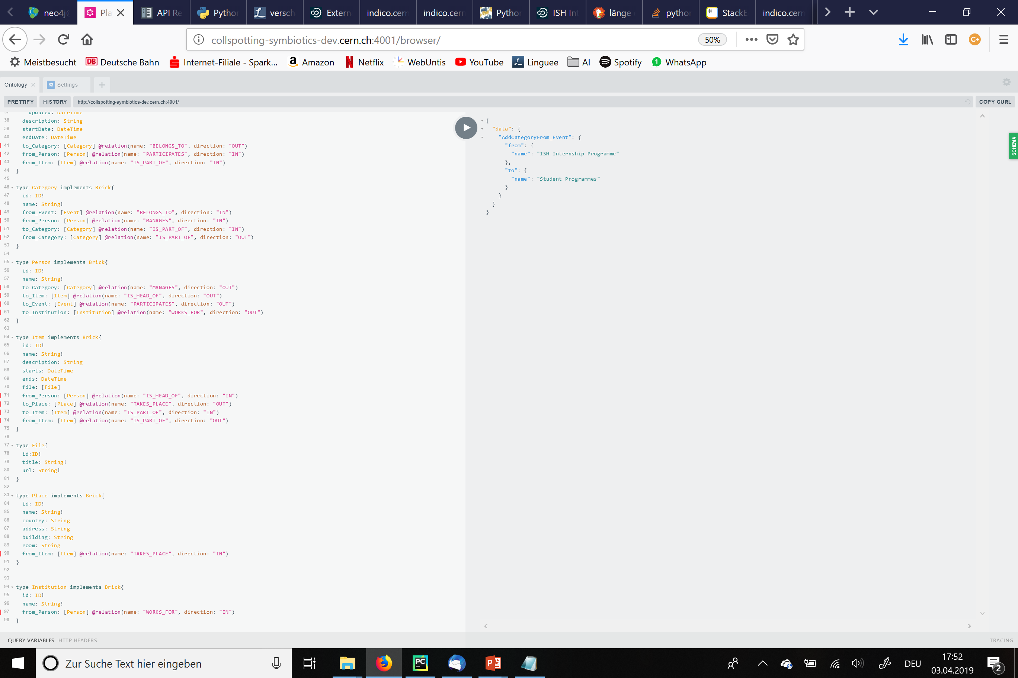
Our own Schema of Indico

Slide 14
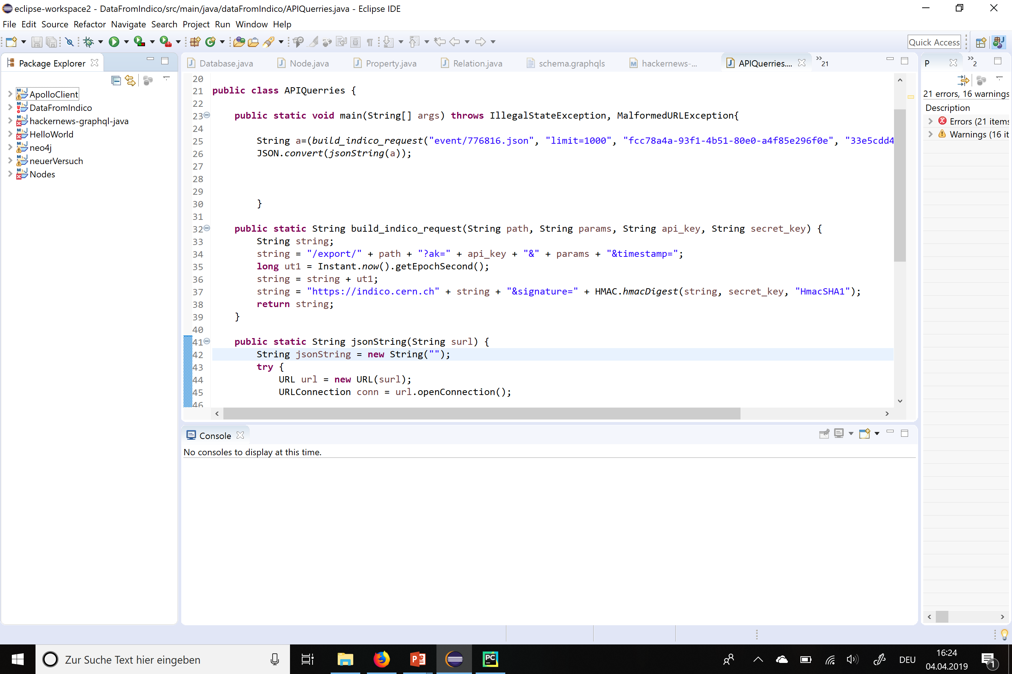
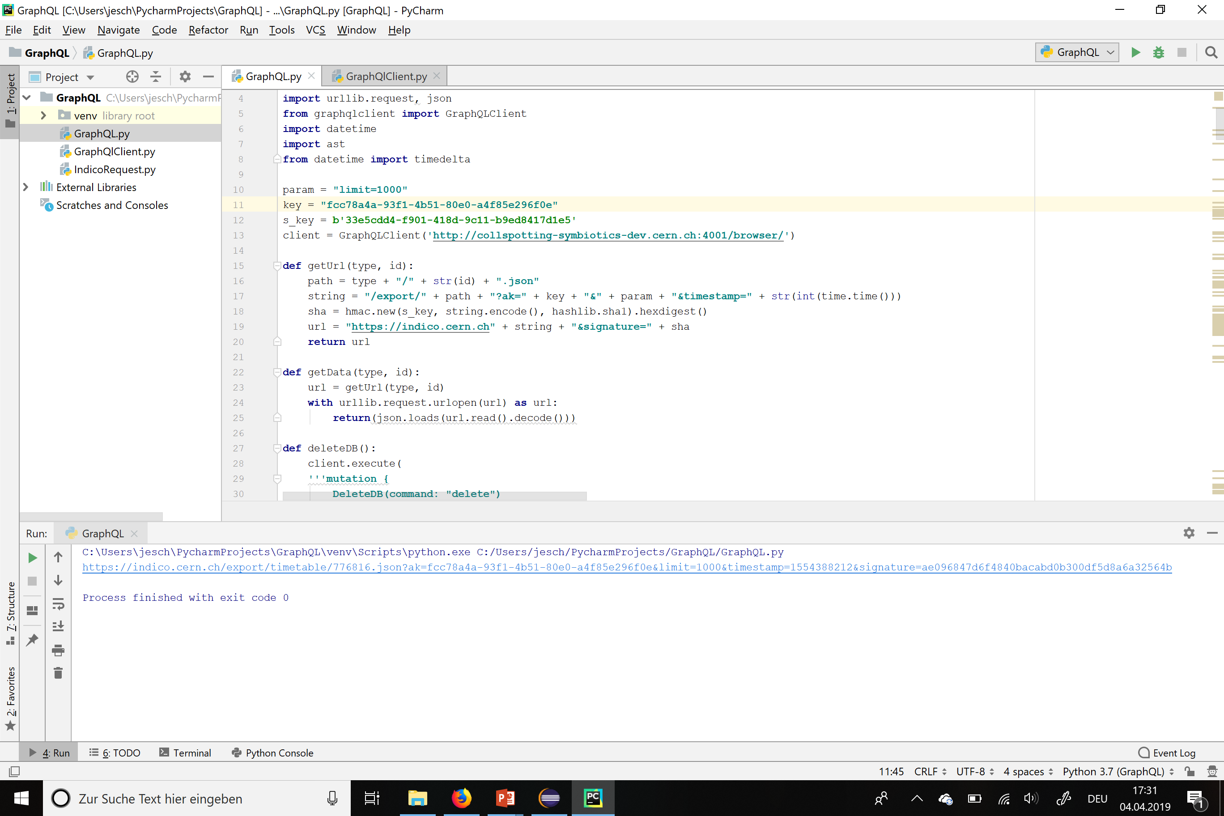
Getting the Information from Indico
URL to get a JSON Object from the Indico API:
http://my.indico.server/export/WHAT/ID.json?PARAMS&ak=KEY&timestamp=TS&signature=SIG
Notes:
Specific URL to get a JSON Object for one event/category/timetable

Slide 15
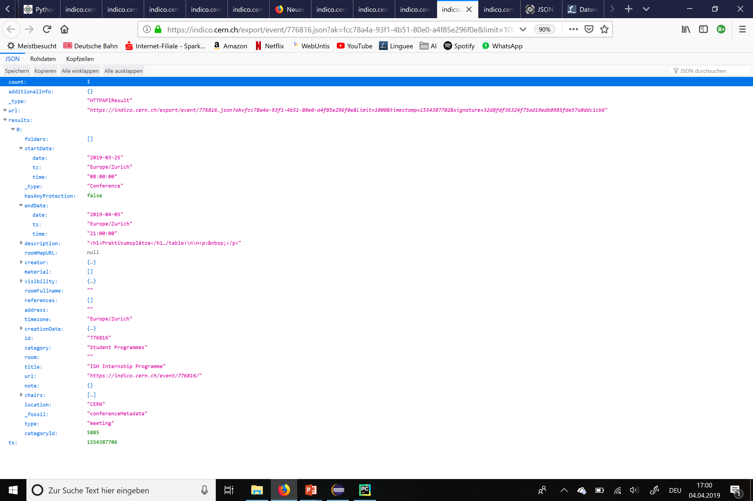
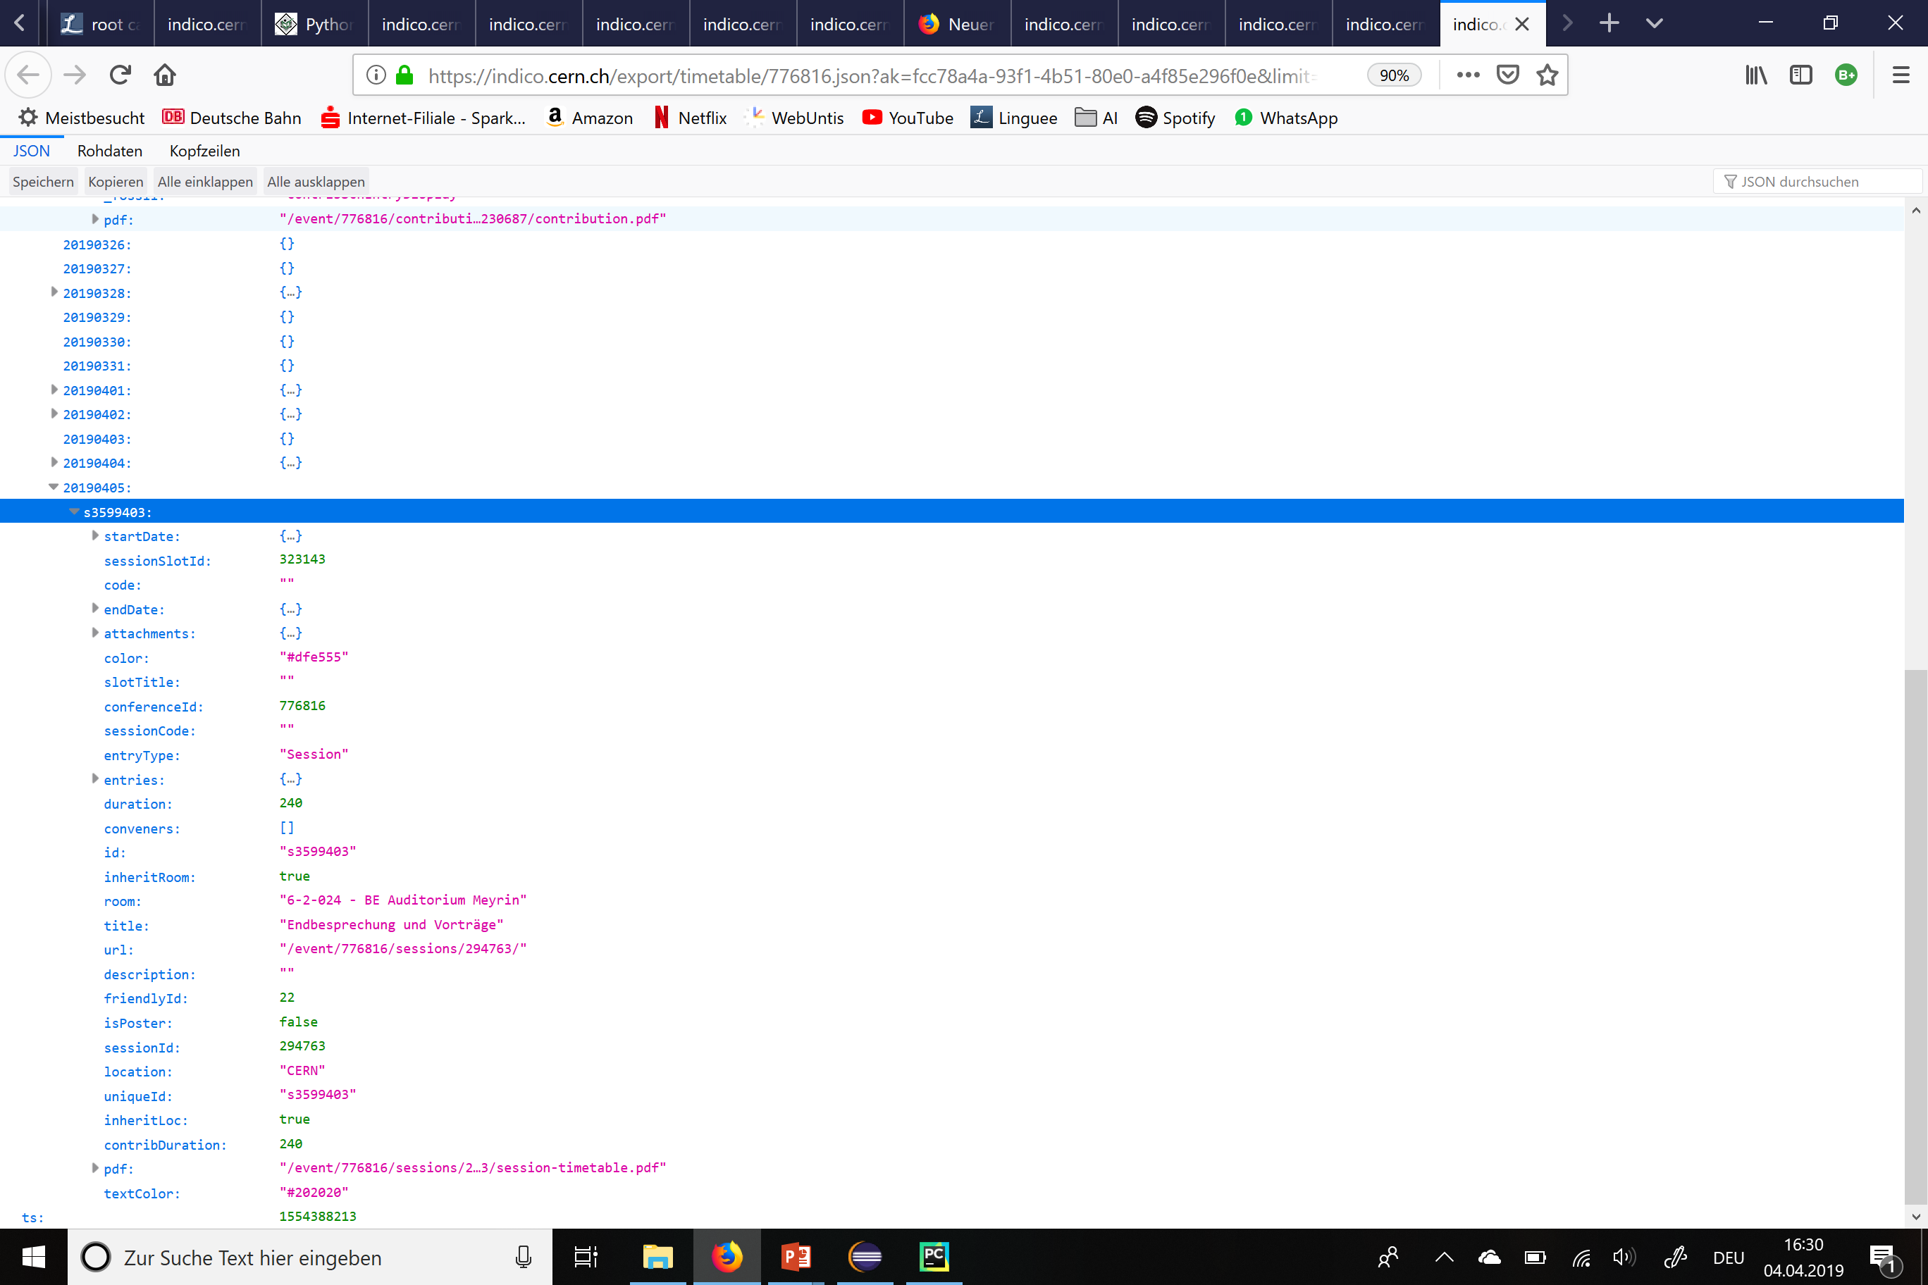
Getting the Information from Indico
Event:
Item:
Notes:
JSON-Datei:

Slide 16
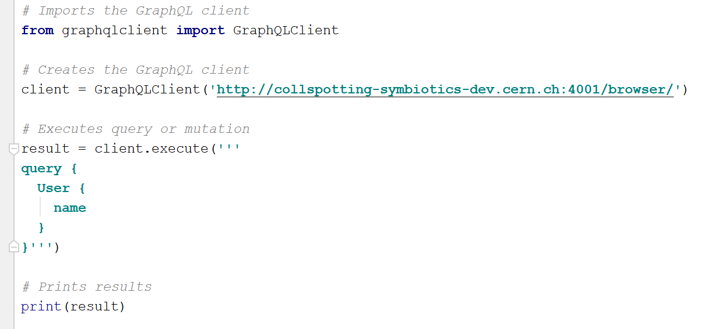
Connection between Python and graphQL
Notes:
Failure with Java

Slide 17
Creating an Event
Notes:
Failure with Java

Slide 18
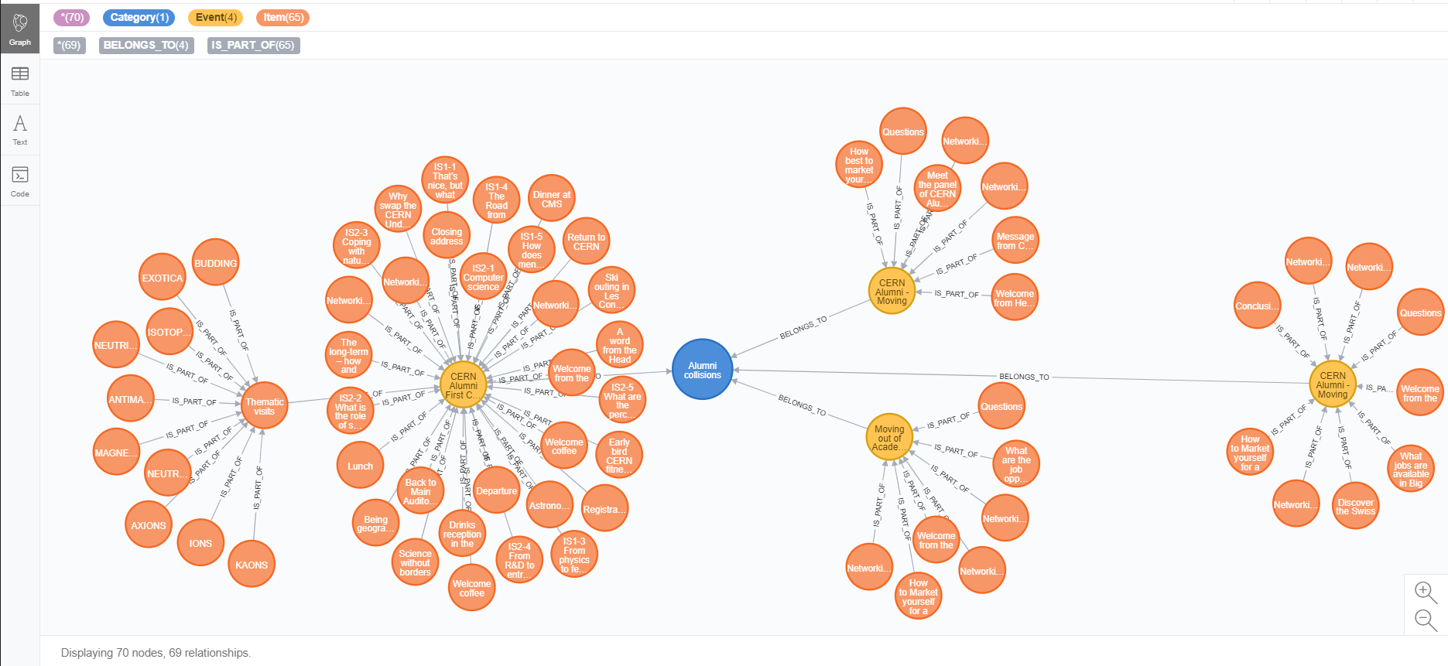
Creating all Events of One Category
Notes:
Failure with Java

